Slide 1

CRIME AND INCOME BY ZIP CODE IN METRO MINNEAPOLIS IN 2015
Haitham Mostafa, Nebeyu Zewdie,
Snejana Balabanova, Zaheer Rizvi

Slide 2
PROJECT AIM & NULL HYPOTHESIS
Aim
Does median income predict crime rate in Minneapolis zip codes?
Do wealthier neighborhoods have higher or lower crime rates?
Do wealthier neighborhoods have higher incidence of white collar crime?
Does income level determine what type of crime is committed?
Null Hypothesis
There is NO correlation between income by zip code and occurrence of crime.
Notes:
There is a NOT correlation between income by zip code and occurrence of crimes.

Slide 3
DATA AND BACKGROUND
Background
Minneapolis has 22 unique zip codes.
We analyzed several crime and IRS income databases to find answers:
Crime Statistics by description of crime committed, reported Open Minneapolis crime database. This database contains every crime reported to MPD in 2015
Income data was provided by the IRS public data by zip code.
Combining three separate databases provides insights into geographical crime and how income affects rate of crime.

Slide 4
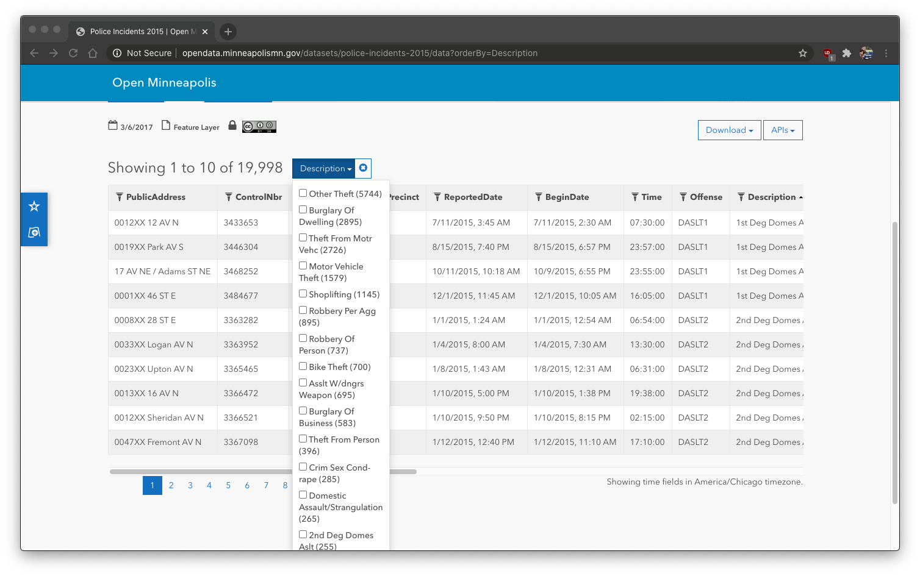
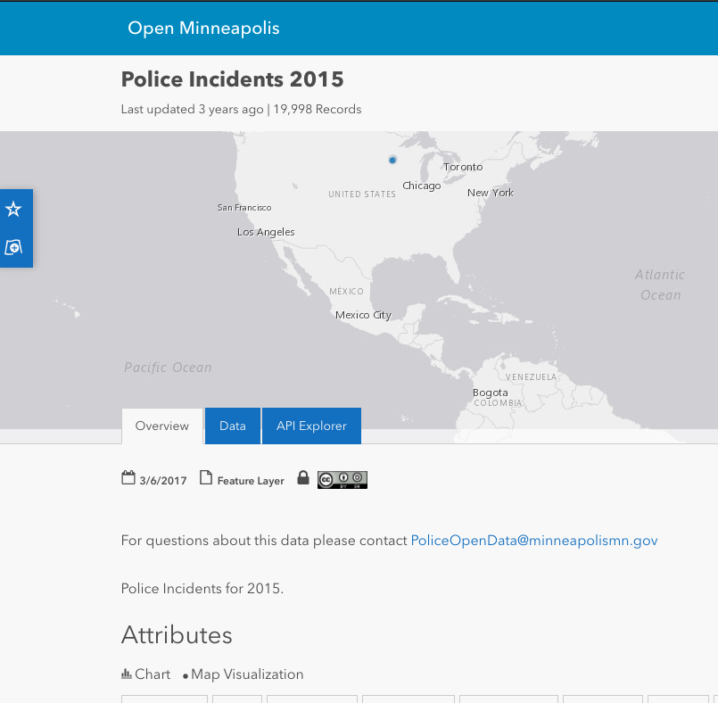
Police incidents 2015
Starting from a database from Open Minneapolis we sorted by Description of crime incident and chose to analyze the top three types of crime in Minneapolis in 2015.
Steps are:
Import CSV file from Open Minneapolis into pandas
Sort by Description of crime and separate into three data frames of the top three types of crime.
Theft
Burglary of Dwelling
Theft from Motor Vehicle
Using Lat & Long from data frame and GoogleMapsAPI add zip code to each crime type data frame. (This was done to compare to IRS database)
Take coordinates of incidents (lat & long) and create a map to illustrate location of incident.

Slide 5
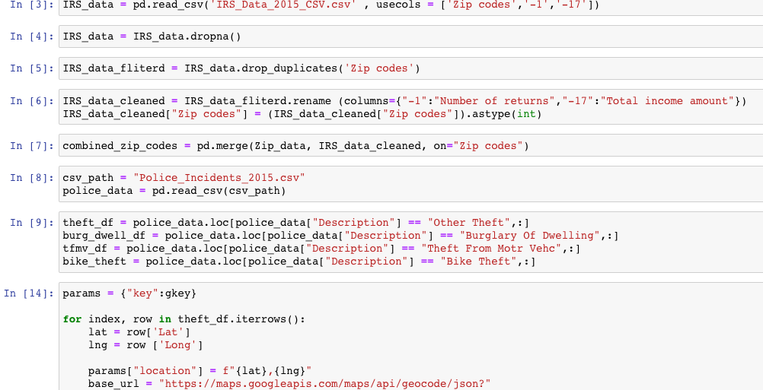
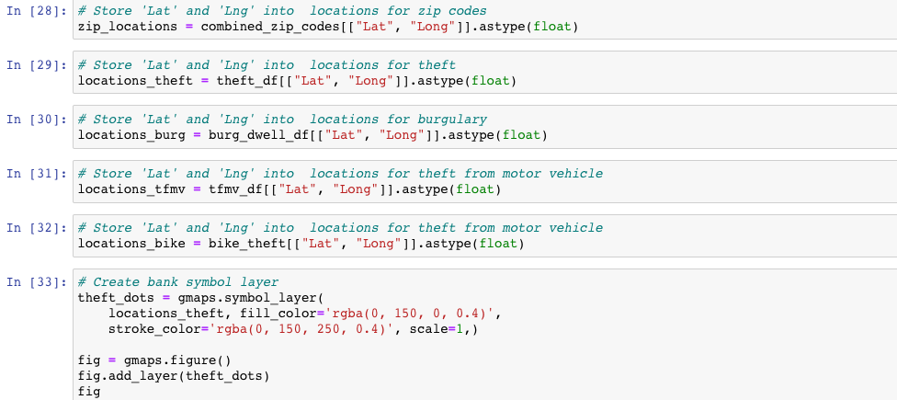
DATA EXPLORATION AND CLEANUP
Here is a glimpse into our data clean up of the IRS database.
Load and read both CSV files (IRS data and Zip code data)
Drop NA values from the data.
Drop the duplicates from the Zip codes column.
Renamed columns in order to sort them
Merged both CSV files to include (Zip codes, Lat, Long ,Number of returns , & Total income amount)
Here is a glimpse into the creation of our incident of crime heat map.
In this clip of code we see the locations are saved then sent into gmaps
We then create a figure of locations of where each incident occurred.
Finally we overlapped this figure and a figure of income by zipcode to view crime incidents vs zip code.

Slide 6
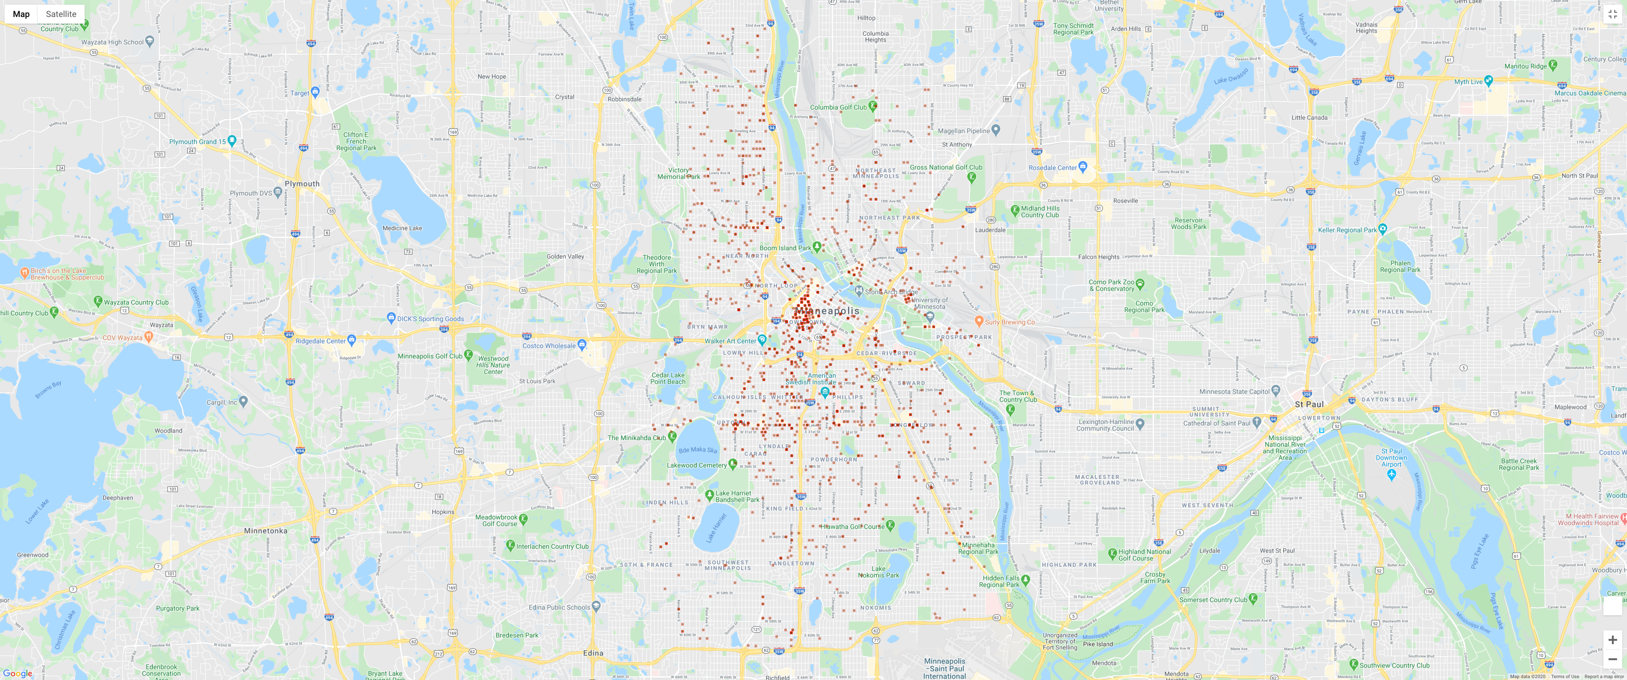
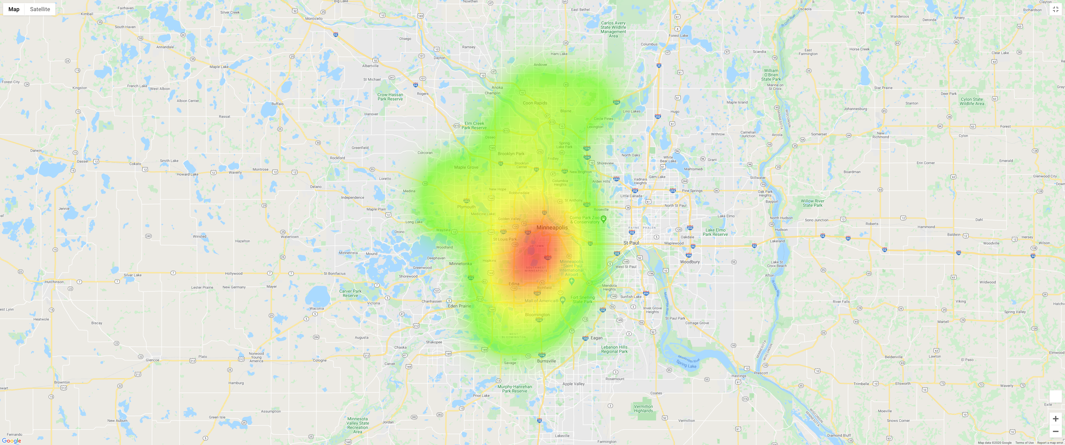
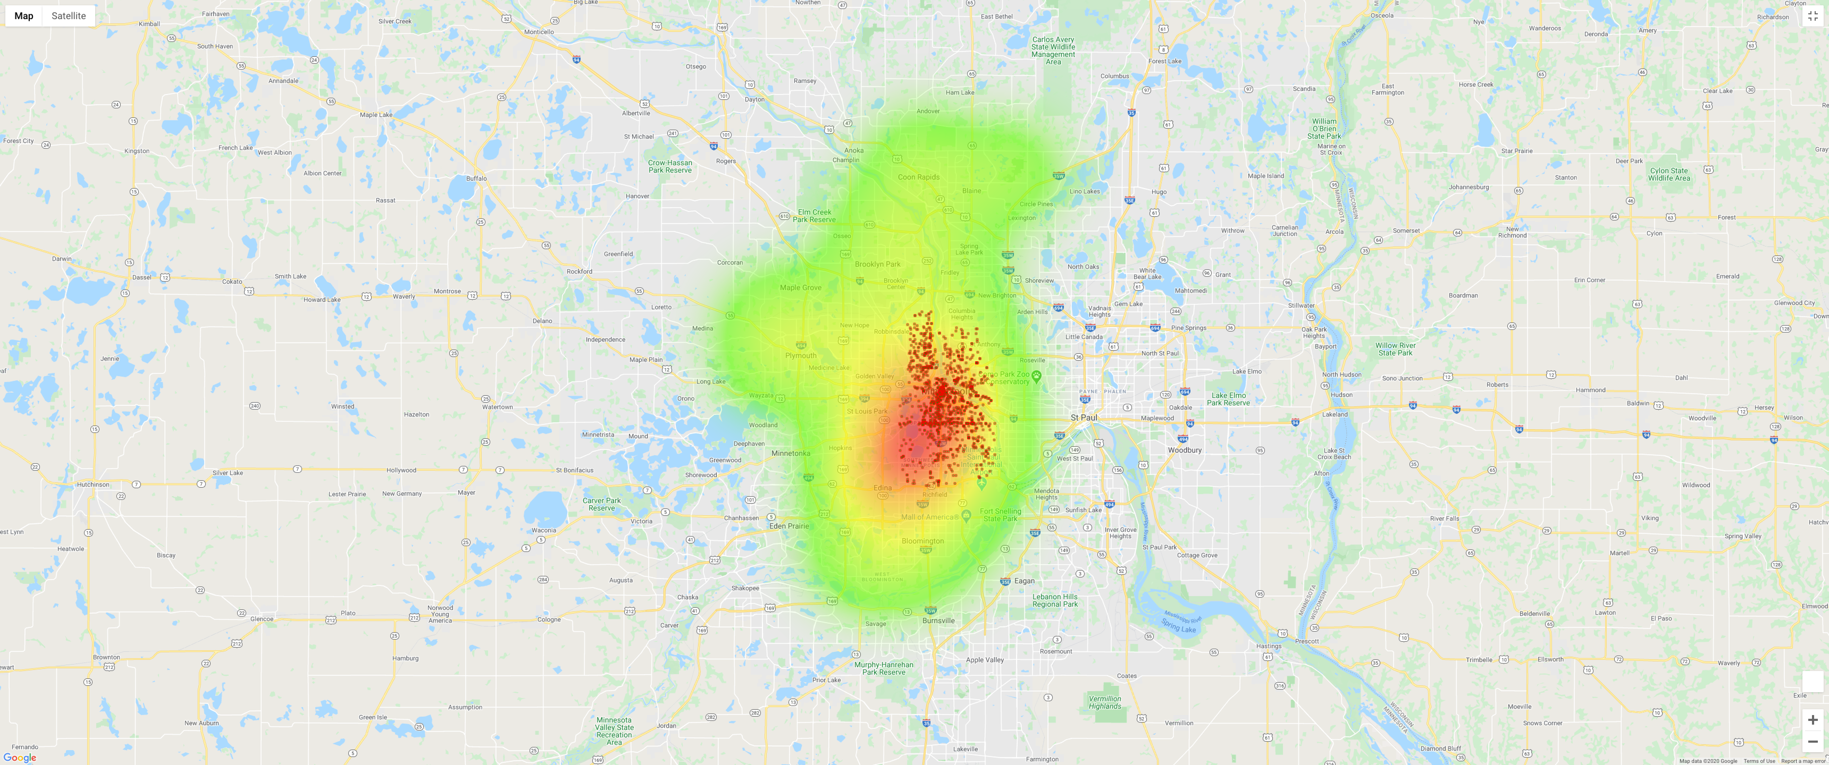
Theft incidents HEAT MAPS
Incidents
Income heat map
Overlay
Notes:
Data Analysis
Discuss the steps you took to analyze the data and answer each question you asked in your proposal
Present and discuss interesting figures developed during analysis, ideally with the help of Jupyter Notebook

Slide 7
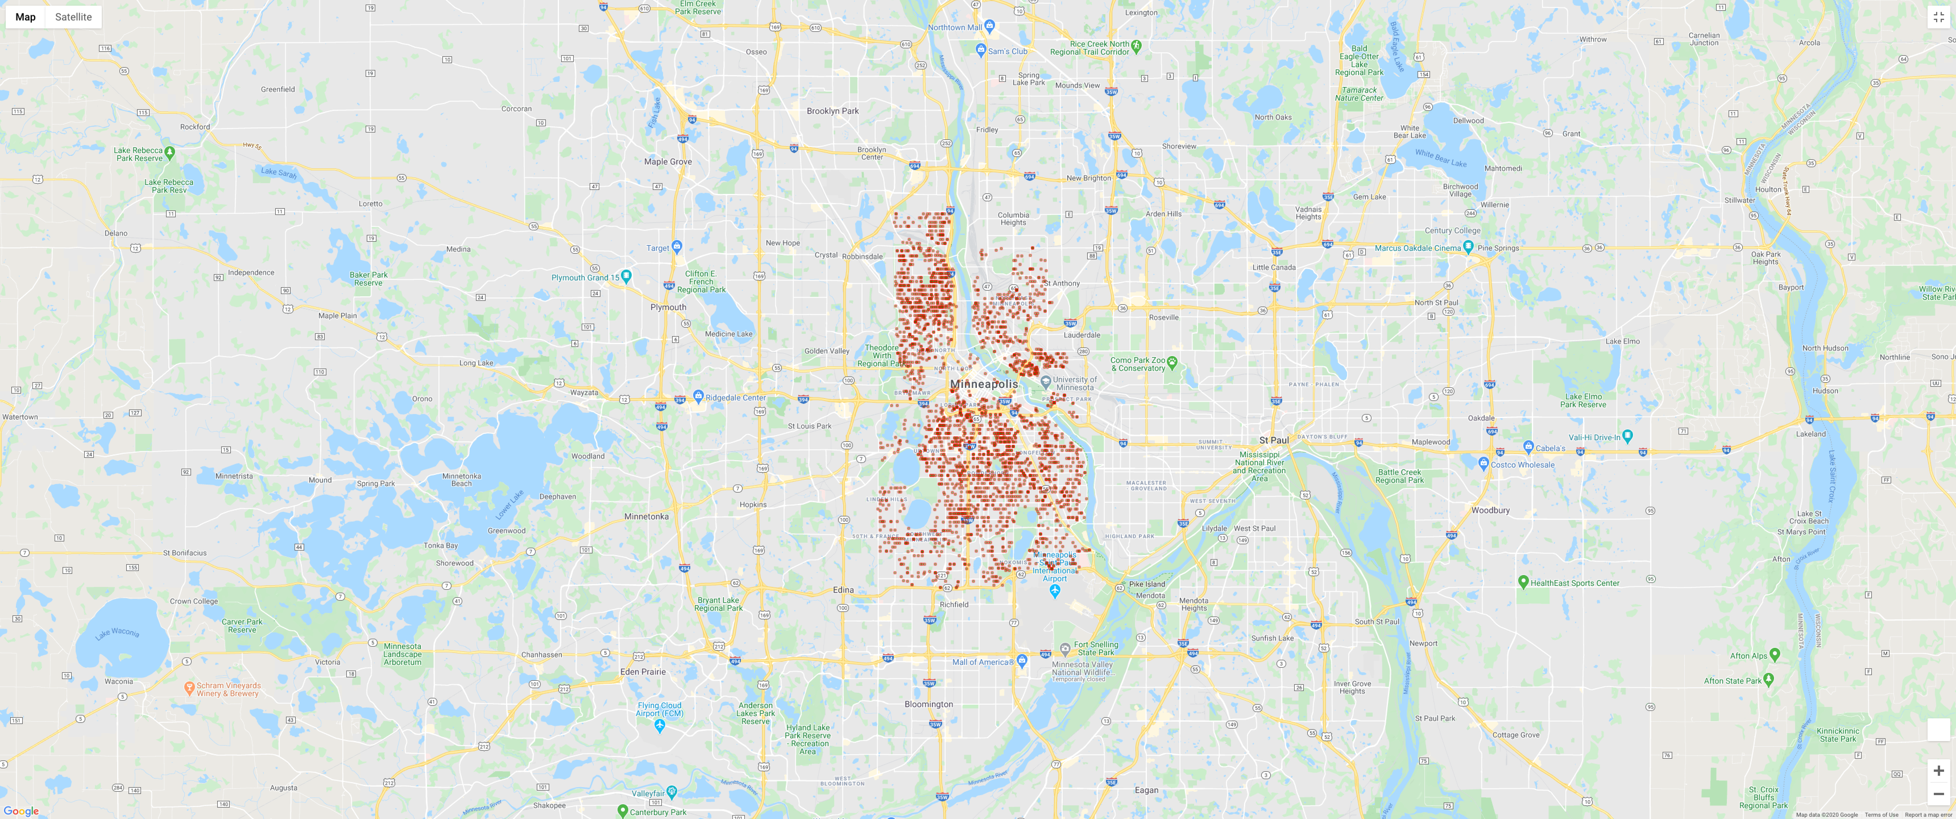
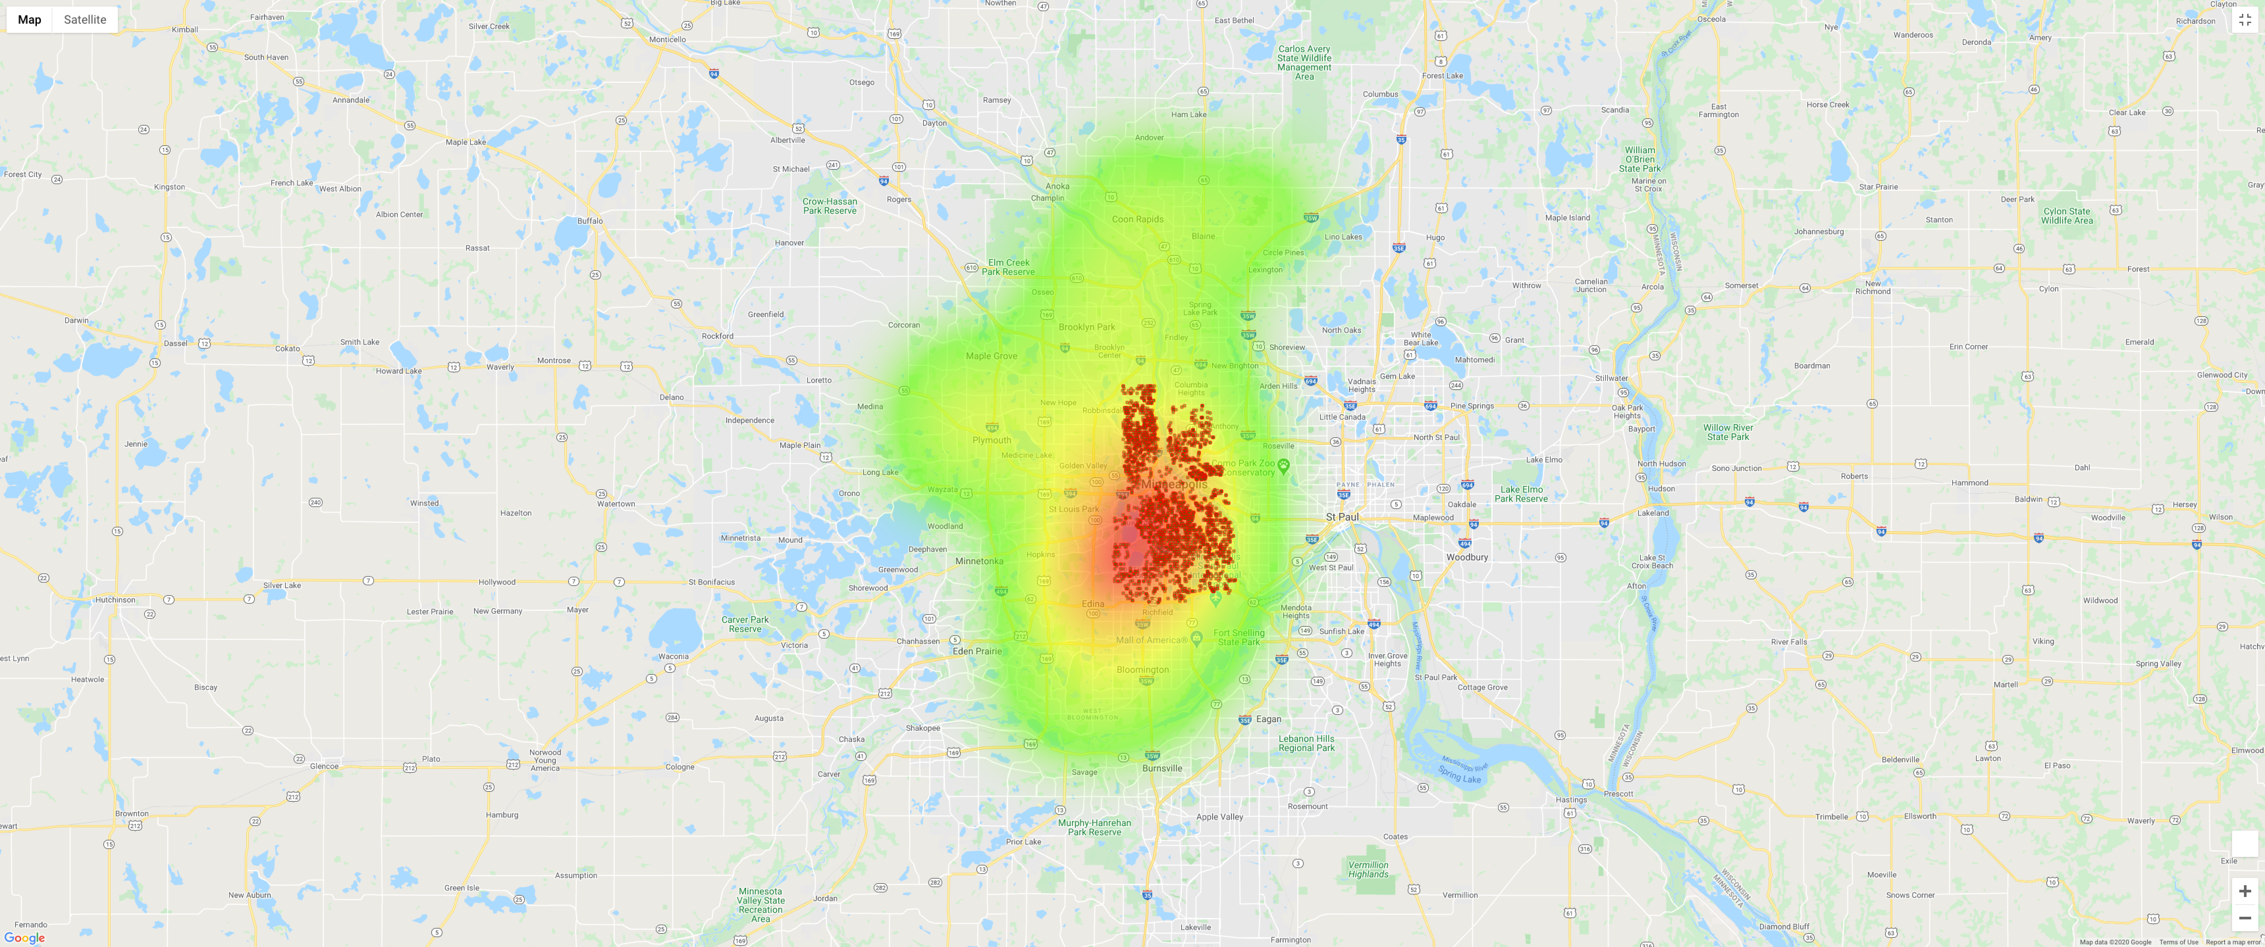
Burglary of dwelling incidents HEAT MAP
Incidents
Income heat map
Overlay
Notes:
Data Analysis
Discuss the steps you took to analyze the data and answer each question you asked in your proposal
Present and discuss interesting figures developed during analysis, ideally with the help of Jupyter Notebook

Slide 8
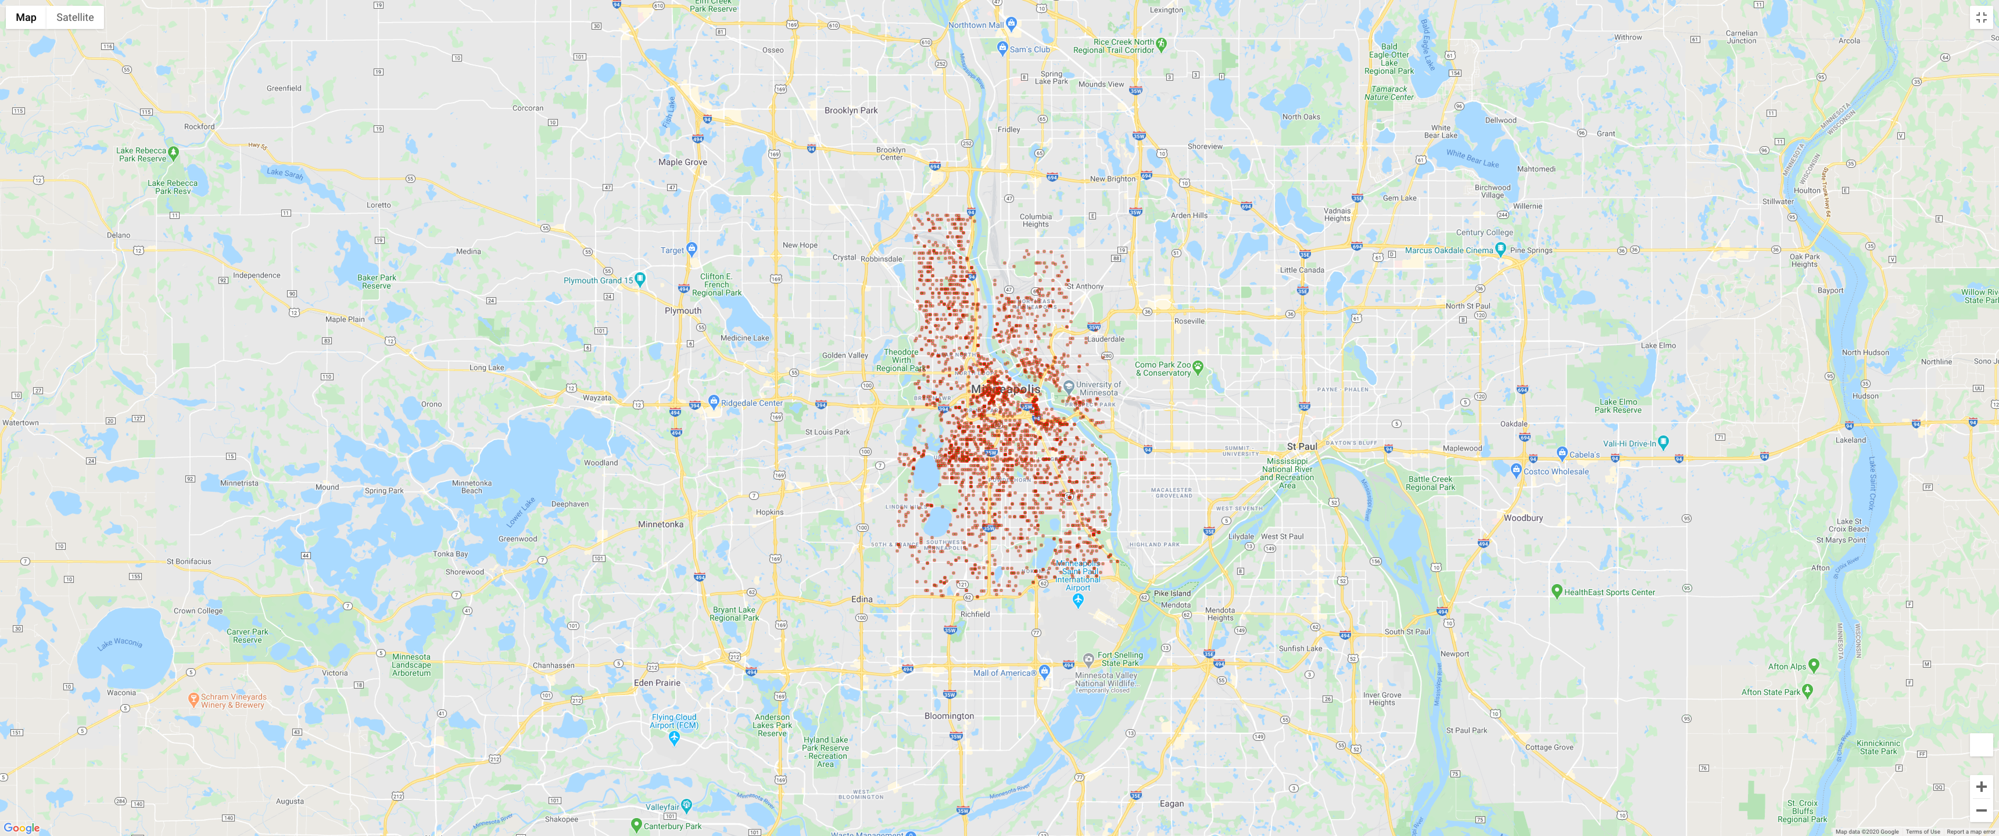

Theft from motor vehicle HEAT MAP
Incidents
Income heat map
Overlay
Notes:
Data Analysis
Discuss the steps you took to analyze the data and answer each question you asked in your proposal
Present and discuss interesting figures developed during analysis, ideally with the help of Jupyter Notebook

Slide 9
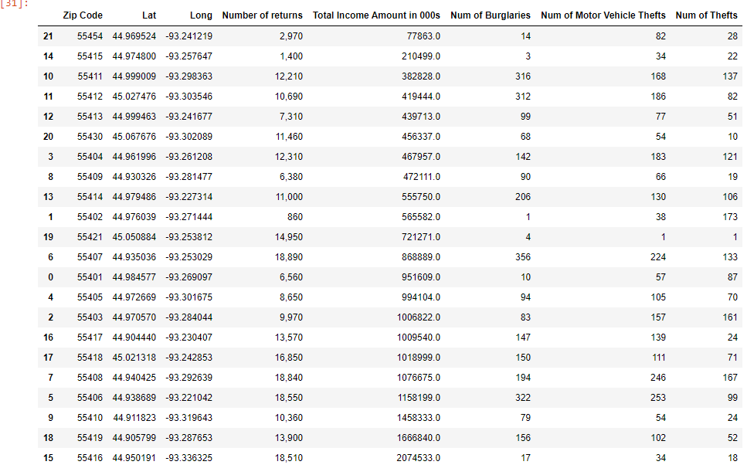
SUMMARY TABLE OF INCOME BY ZIP CODE AND CRIME TYPE
Notes:
Data Analysis
Discuss the steps you took to analyze the data and answer each question you asked in your proposal
Present and discuss interesting figures developed during analysis, ideally with the help of Jupyter Notebook

Slide 10
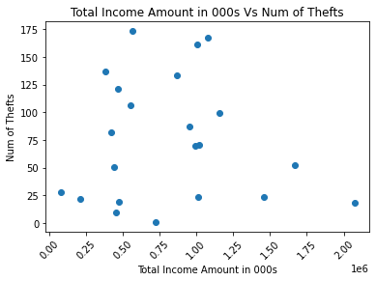
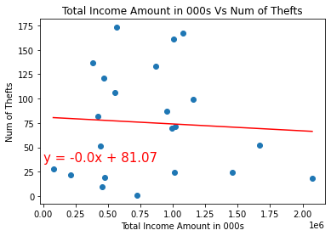
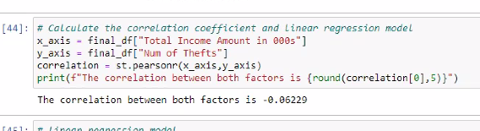
ANALYSIS PROCESS for Thefts
P-Value = 0.78302

Slide 11
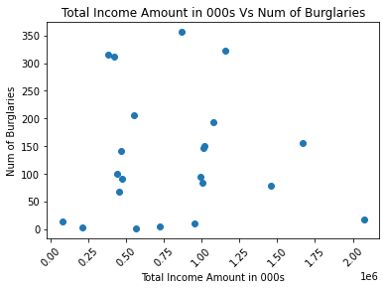
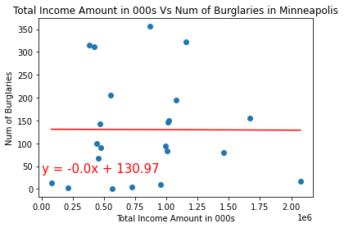
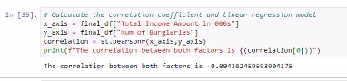
ANALYSIS PROCESS for Burglary of dwelling
P-Value = 0.98463

Slide 12
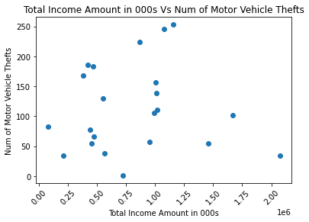
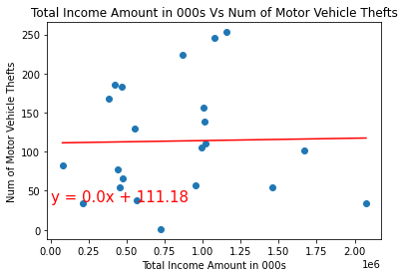
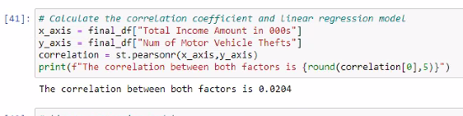
ANALYSIS PROCESS for Theft from a motor vehicle
P-Value = 0.9282

Slide 13
OUR FINDINGS
WE FAILED TO REJECT OUR NULL HYPOTHESIS
There is no correlation between income by zip code and occurrence of crime in Minneapolis in the year 2015.
Limitations:
Total income by zip code includes total as calculated with the IRS data file (sum of individual income brackets and not a weighted average per return).
Data is not normalized for zip code population density. If project was redone was worth pursuing.
There are other factors affecting police incidents
Do wealthier neighborhoods have higher or lower crime rates?
Do wealthier neighborhoods have higher incidence of white collar crime?
Does income level determine what type of crime is committed?
NO
Notes:
Discussion
Discuss your findings. Did you find what you expected to find? If not, why not? What inferences or general conclusions can you draw from your analysis?
Post Mortem
Discuss any difficulties that arose, and how you dealt with them
Discuss any additional questions that came up, but which you didn't have time to answer: What would you research next, if you had two more weeks?

Slide 14
QUESTIONs
?
Notes:
Questions
Open-floor Q&A with the audience

